Slide 1
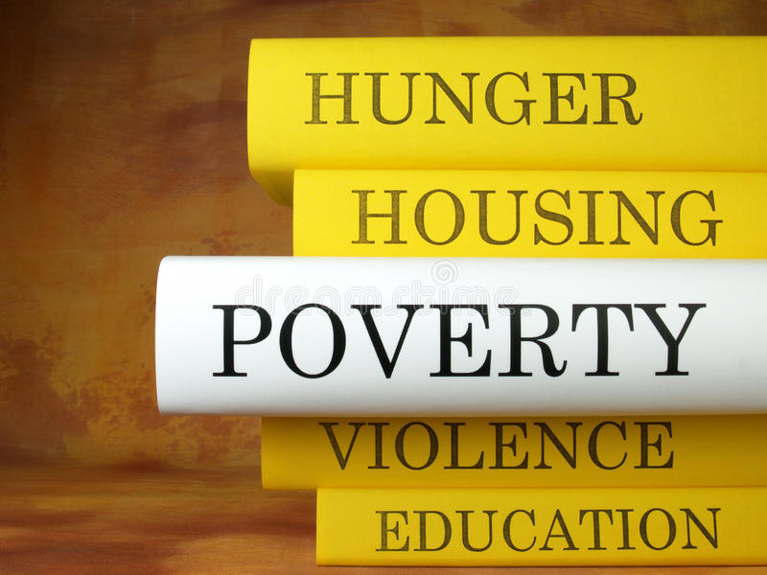
HUM1039 Project
Decreasing Poverty in Rural and Urban Communities
MOHAMED ASHRAF ALI (20BCE1630)
HRITHIK D (20BCE1689)
DEVARINTI DHAPATLA
PUNEETH REDDY (20BCE1852)
SANJIL K C (20BCE1855)
LENIN VASAN (20BCE1892)
http://www.free-powerpoint-templates-design.com

Slide 2

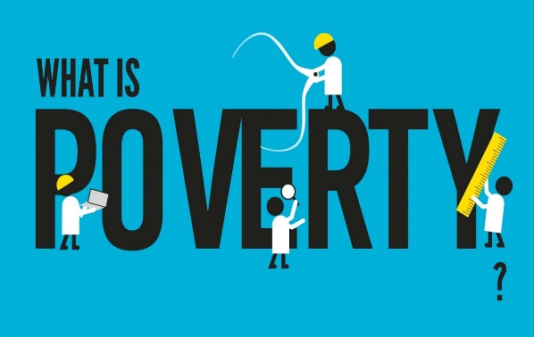
Poverty is hunger. Poverty is lack of shelter. Poverty is being sick and not being able to see a doctor. Poverty is not having access to school and not knowing how to read. Poverty is not having a job, is fear for the future, living one day at a time.
Poverty has many faces, changing from place to place and across time, and has been described in many ways. Most often, poverty is a situation people want to escape. So poverty is a call to action -- for the poor and the wealthy alike -- a call to change the world so that many more may have enough to eat, adequate shelter, access to education and health, protection from violence, and a voice in what happens in their communities.

Slide 3
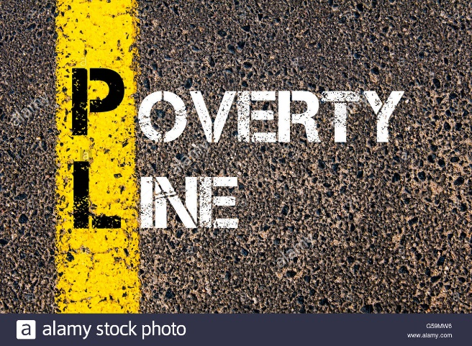
Poverty line is the level of income to meet the minimum living conditions. Poverty line is the amount of money needed for a person to meet his basic needs. It is defined as the money value of the goods and services needed to provide basic welfare to an individual.
International Standards
People living below a poverty line don't have enough to meet their basic needs. Countries typically define national poverty lines, and we use the lines of a group of the poorest countries to define the international extreme poverty line of $1.90 per day.
Indian Standards
Monthly per capita consumption expenditure of Rs. 972 in rural areas and Rs. 1407 in urban areas is recommended as the poverty line at the all India level.

Slide 4
Abstract
Oxfam commissioned a new global survey done by 295 economists from 79 countries. The report expects a major increase in income inequality in India and other countries.
People have lost their jobs during the COVID-19 pandemic at a very high rate.
Monthly per capita consumption expenditure of Rs.972/- in rural areas and rupees Rs.1407/- in urban areas is recommended as the poverty line at the all of India level. It is said that 28% of the Indian population lives below the poverty line.
We are going to provide jobs to the people to develop their source of income and to come out from the poverty line. These jobs are also going to be for the well being of our people and nation.

Slide 5
Abstract
Rural Area
Rural development is the process of improving the quality of life and economic well-being of people living in rural areas. According to 2011
Census 68.84% of population lives in villages. The backwardness of the rural sector would be a major impediment to the overall progress of the
economy. India is predominately an agricultural country and farming is their main occupation. According to 2011 Agricultural Census of India, an
estimated 61.5% dependent on agriculture. Technical developments in field of agriculture have increased the gap between the rich and poor, as the
better off farmers adopted modern farm technology to a greater extent than the small farmers. The all India Rural Credit Review Committee in its
report warned “If the fruits of development continue to be denied to the large sections of rural community, while prosperity accrues to some, the
tensions social and economic may not only upset the process of orderly and peaceful change in the rural economy but even frustrate the national
affords to set up agricultural production.’’ Report of the All India Rural Credit Committee, New Delhi, 2003 has rightly pointed out that a purely
agricultural country remains backward even in respect of agriculture. Most of the labour force in India depends on agriculture, not because it is
remunerative but because there are no alternative employment opportunities. This is a major cause for the backwardness of Indian agriculture. A
part of the labour force now engaged in agriculture needs to be shifted to non-agricultural occupations.

Slide 6
Abstract
Urban Area
Urban centres in India have played significant role in shaping the cultural landscape since ancient time. Presently urban population accounts for 27.78 % of the total population and is likely to go up to 50% by 2051.As compared to the world scenario the figure may not seem alarming but in terms of absolute number it is the second largest urban system. There has been a consistent increase in the number of urban centres and urban population. In the last 50 years the urban population has increased by four times. There has also been massive increase in the class one cities and their contribution in urban population. It is estimated that the contribution of urban sector to the GDP has increased from29 % in1951 to 65 % in 2001 and 90% of the revenue comes from the urban sector. Cities are considered to be the engine of economic growth and provider of jobs, services and assurance for better quality of life. This has promoted the influx of population from small towns and rural areas to big cities leading to the proliferation of squatters and slums, growth of informal sector and acute pressure on basic urban amenities. This would culminate in the poor city governance and the urbanization of poverty. Hence, there is a need to handle the problem of urbanisation professionally by bringing various actors and sectors at a common platform, identify the problems in a wider perspective and try to solve them by creating synergy. In the above backdrop the present paper will discuss the pattern of urbanisation at macro level, changes in the pattern of urban growth, impact of urbanisation on urban environment and role of geographer in urban development and management.

Slide 7
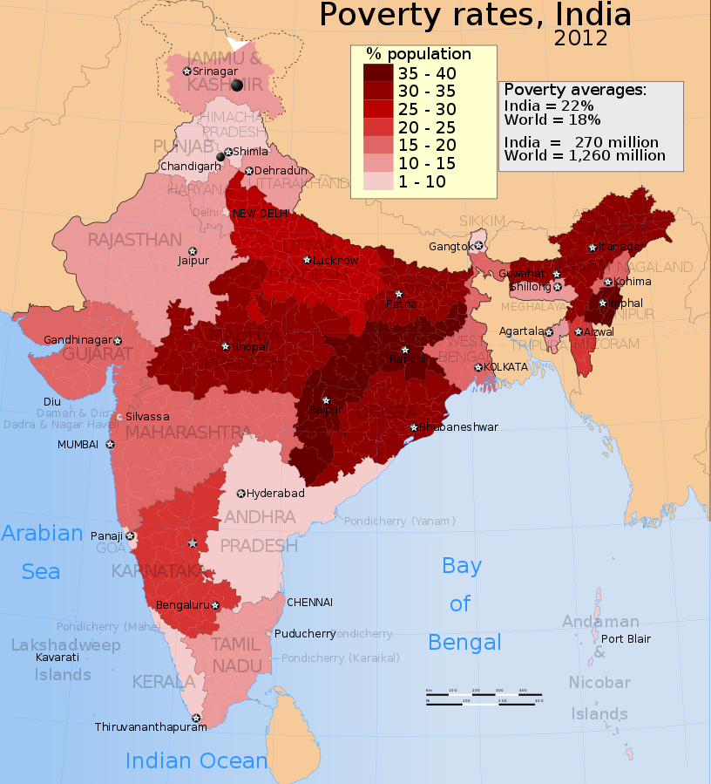
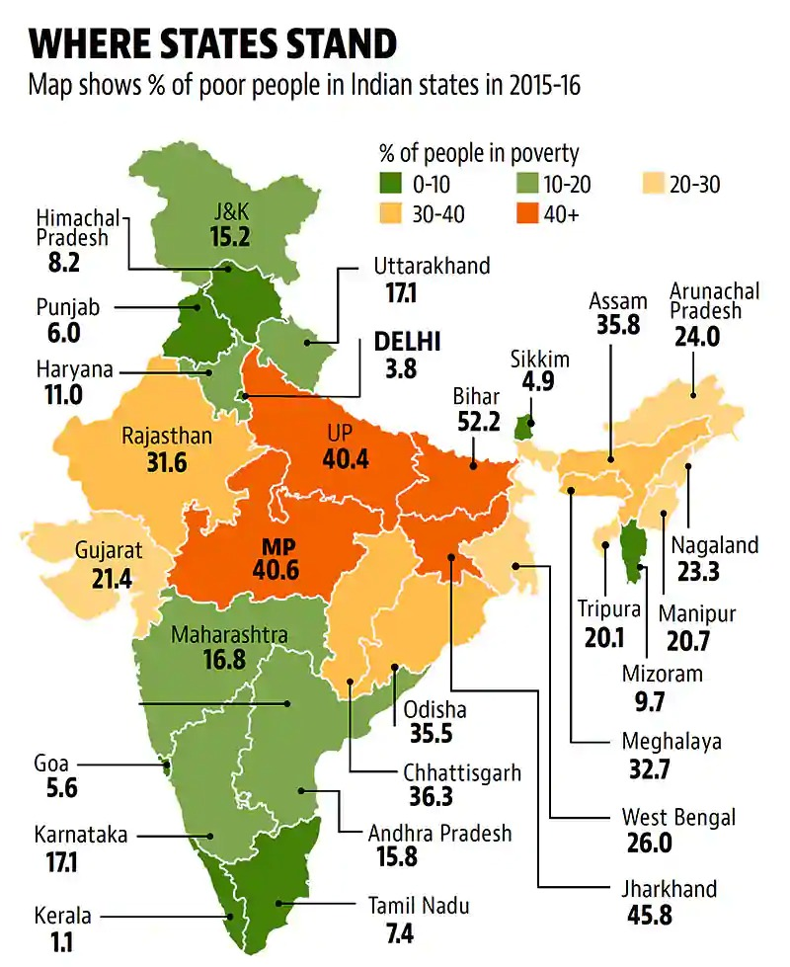

Slide 8
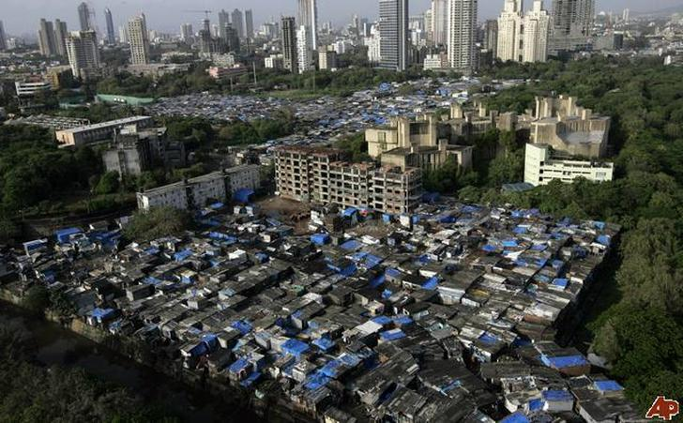
Problems faced by people in poverty line
Caste | % Of total population | No. of People
FC | 28.0% | 357M
OBC | 44.1% | 563M
SC | 19.0% | 242M
ST | 8.9% | 114M
Total | 100% | 1276M
Caste | % Of total population | Poverty % over poverty population
FC | 28.0% | 15.9%
OBC | 44.1% | 41.4%
SC | 19.0% | 25.3%
ST | 8.9% | 17.4%

Slide 9
1.Social Discrimination
They are considered lethargic, inefficient and a burden on the society. They are harassed, humiliated and discriminated against at every level. Being unrepresented and powerless, they are al­ways the targets of attack and hostility by the powerful. They have to face the challenges of illiteracy and social prejudice. They are accused and labelled as undisciplined, immature, having very little foresight.
2.Housing
Houselessness, overcrowding, slums and rental laws are serious prob­lems in urban areas. The houses of the poor are not only over-crowded but lack privacy.
3.Subculture of Poverty
Kriegberg has said that although the membership of the poor changes to an important degree over the generations, the successive generations resemble each other in behaviour and values as a product of the common experiences of being poor and of being subjected to similar social pressures. The children of the poor inherit a subculture of violence in which physically aggressive responses are either expected or required by all members.
4.High Infant mortality
1.4 million children die each year in India before their fifth birthday. In addition to Nigeria, Pakistan, the Democratic Republic of the Congo and China, India is one of the countries with the highest child mortality rates. Pneumonia, malaria and diarrheal diseases as well as chronic malnutrition are the most frequent causes of death.

Slide 10
5.Health Care
Only about 10% of the poorest one-fifth of Indians in rural (10.2%) and urban India (9.8%) had any form of private or government health insurance, show data from India’s largest national survey on social consumption, conducted between July 2017 and June 2018. The poor are routinely forced to dip into their savings, borrow, delay treatment or receive poor quality care, experts said. Overall, few Indians--14.1% in rural areas and 19.1% in urban areas--had any form of health coverage, found the report by the National Survey Office (NSO) of the Ministry of Statistics and Programme Implementation. This leaves the vast majority of Indians exposed to health-related financial shocks.
6.Malnutrition
India is one of the world’s top countries when it comes to malnutrition: More than 200 million people don’t have sufficient access to food, including 61 million children. 7.8 million infants were found to have a birth weight of less than 2.5 kilograms - alarming figures for a country commonly referred to as the emerging market.
7.Chlid Marriage
In spite of banning minors from marrying in 2006, it is still widespread in many regions of India. The main leaders in this practice are young girls, who are still children themselves and become mothers too early. Many of them die at birth. According to an investigation by the medical journal The Lancet, 44.5% of girls are still married in India before they are of legal age. Due to poverty, many parents encourage early marriages for their daughters in hopes of better lives for them.
8.Water,Saanitation, Hygiene
India has made rapid progress in ending open defecation across the Country which is having a huge impact on improving water, sanitation and hygiene (WASH). In 2015, India alone accounted for 90 per cent of the people in South Asia and half of the 1.2 billion people in the world that defecated in the open. The risk of spreading diarrheal and waterborne diseases is compounded by the lack of regular handwashing and microbial contamination of water in their homes and communities. The situation contributed to nearly 100,000 diarrhoeal deaths of children under five years in India.

Slide 11
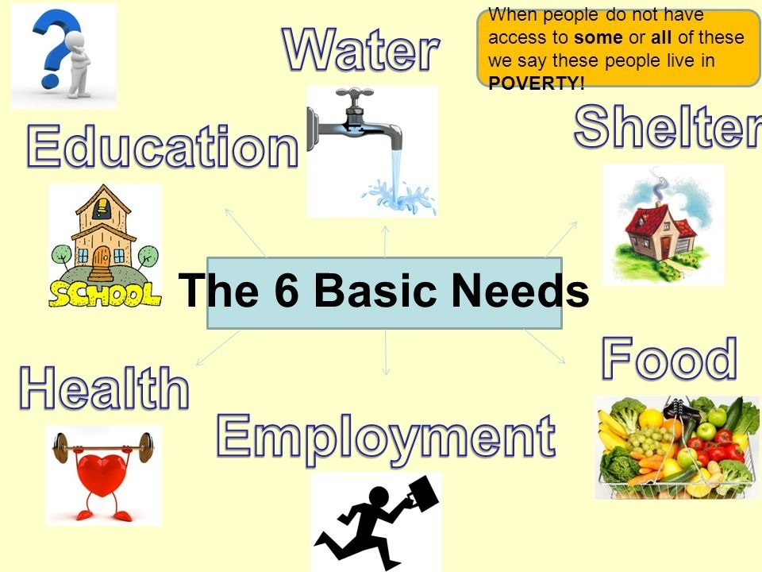
Basic needs for people in poverty line
Shelter and
Housing
Employment
Food
Health Care
Water
Education

Slide 12

Basic needs for people in poverty line
Poverty is the lack of basic human needs. Such as clean drinking water, nutritious food, clothes, shelter, health care an education .many of the people don’t have the inability to afford them.
Food
Many people are facing many issues, they are not able to eat the food a single time a day. Even for that one meal they are working hard and depending on other people to help them. On an average a person needs a minimum amount of 1200 calories per day to healthy and fit.
01
Shelter and Housing
02
In India many of the poor people don’t have proper houses to live and they need to travel or a long distance for proper drinking water.
Health Care
03
And even people are not able to afford for the hospitals. Health services are decreased day by day. If any health issue poor people are also forced to go to the private hospitals which are very difficult to afford by them.

Slide 13

Basic needs for people in poverty line
Education
Education is fundamental to development and growth. Education can be the catalyst needed to pull families and communities out of the cycle of poverty. Knowledge gives children the power to dream of a better future and the confidence needed to pursue a full education, which in turn will help generations to come.
04
05
Water
The water industry estimates that an average person uses 3,000 gallons of water monthly, so a family of 4 would use 12,000 gallons for bathing, cooking, washing, recreation and watering.
The minimum water requirement for fluid replacement for a 70kg human in a temperate zone equates to 3L per day, or 42.9mL/kg. Minimum requirements for an individual the same size but in a tropical zone equates to 4.1 to 6L/day, or 58.6 to 85.7mL/kg.

Slide 14
HOW TO REDUCE POVERTY LINE IN INDIA :
Poverty line can be defined as “The conventional approach to measuring poverty is to specify a minimum expenditure (or income) required to purchase a basket of goods and services necessary to satisfy basic human needs and this minimum expenditure is called the poverty line”. Absolute poverty can be characterized by severe deprivation of basic needs a human need to sustain life. Those needs include: drinking water, health, shelter, clothes, education, information, sanitation facilities, etc. It also depends on access to basic social services.
There are a lot of ways to increase the standard of living of people. One of the best ways to get them out of the poverty line is getting a well-payed job. The unemployment of these people is generally the major cause for poverty. They have almost no source of income without being employed. Rising employment rate also boosts the national economy. Sometime this is not the case. People working hard are found to work as hard as they can to earn an income that is as low as it can be. They require security and a reasonable minimum wage must be implemented and raised. This protects them from being exploited and robbed daylight. Most of the jobs now-a-days are dependent on their skills.

Slide 15
HOW TO REDUCE POVERTY LINE IN INDIA :
CURRENT LEVEL OF POVERTY IN INDIA
The last official estimate of Poverty in 2011-12 was released by Planning Commission at 21.92%, which was estimated using Tendulkar Committee approach. After that, no estimates have been officially released. SDG 2019 Report by Niti Ayog also mentions Tendulkar Poverty Line of 21.92% adopted in 2011 as the official poverty line. It is interesting to know that Global MPI Reports 2019 and 2020 show India’s poverty line for 2011-12 as 21.2% ( for the year 2011- 12), based on World Bank’s 1.90$ poverty line for extreme poverty, quite close to Tendulkar Committee based Poverty line.
CAUSES FOR POVERTY: The causes of poverty lie in the institutional and social factors that mark the life of the poor. The poor are deprived of quality education and unable to acquire skills which fetch better incomes. Also access to health care is denied to the poor. The main victims of caste, religious and other discriminatory practices are poor. These can be caused as a result of (i) social, economic and political inequality (ii) social exclusion (iii) unemployment (iv) indebtedness (v) unequal distribution of wealth. Aggregate poverty is just the sum of individual poverty. Poverty is also explained by general, economy-wide problems, such as (i) low capital formation (ii) lack of infrastructure (iii) lack of demand (iv) pressure of population (v) lack of social/ welfare nets.
If we resolve the major issues which mentioned above then we can overcome the poverty in India.

Slide 16
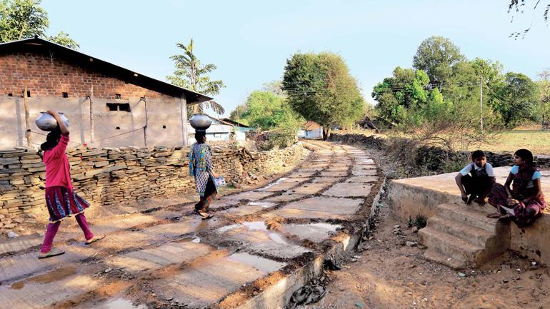
Rural
Providing small cattle animals – like goat, sheep, hen, duck etc.
01
02
Apiculture – for honey and bee waste for bee paper
05
Hemp production cloth, bags, rope, soaps etc.
03
04
06
Daisugi technique for wood

Slide 17
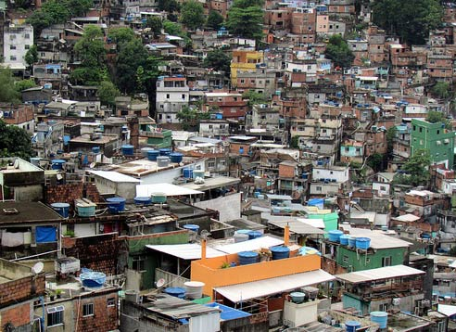
Urban
Biodegradable waste collection - making methane gas and making organic fertiliser
01
Incense sticks from flowers collected from temples all around the city
02
Labour work for many small-scale industries
05
Tapioca plastic production – I am not plastic bags
03
04
Small scale and indigenous industries for handicraft products
06
Vegan leather using cacti

